Slide 1
Algebraic Fractions
EQ – How does having different denominators affect how we add and subtract fractions?
Year 10

Slide 2
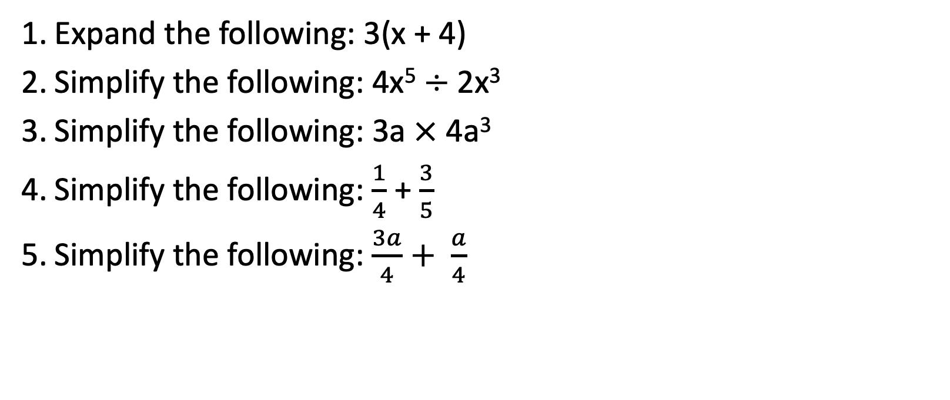
Five Questions (LHS)
Topic: Algebraic Fractions
EQ – How does having different denominators affect how we add and subtract fractions?
Expand the following: 3(x + 4)
Simplify the following: 4x⁵ $÷$2x³
Simplify the following: 3a $×$ 4a³
Simplify the following: $\frac{1}{4}$ + $\frac{3}{5}$
Simplify the following: $\frac{3a}{4}+ \frac{a}{4}$

Slide 3

Learning Intentions
Students will be able to
Define the steps taken to get a Lowest Common Denominator (LCD)
Apply LCD to fractions with different denominators
Add and subtract fractions with different denominators
WICOR

Slide 4

24
7
30
Algebraic Fractions
Date:
EQ – How does having different denominators affect how we add and subtract fractions?
First, a quick review: How do we add and subtract normal fractions that have different denominators?
Ex: S$implify \frac{1}{9}+ \frac{2}{3}$ ?
How would you solve this? What are the steps do you need to take?
Think- On your own, you have two minutes to think of the steps needed to solve this question
Pair- You and a shoulder partner will compare thoughts and come up with a consensus
Share – As a class, we will share ideas and come up with a concrete list of the steps taken to solve the above question

Slide 5
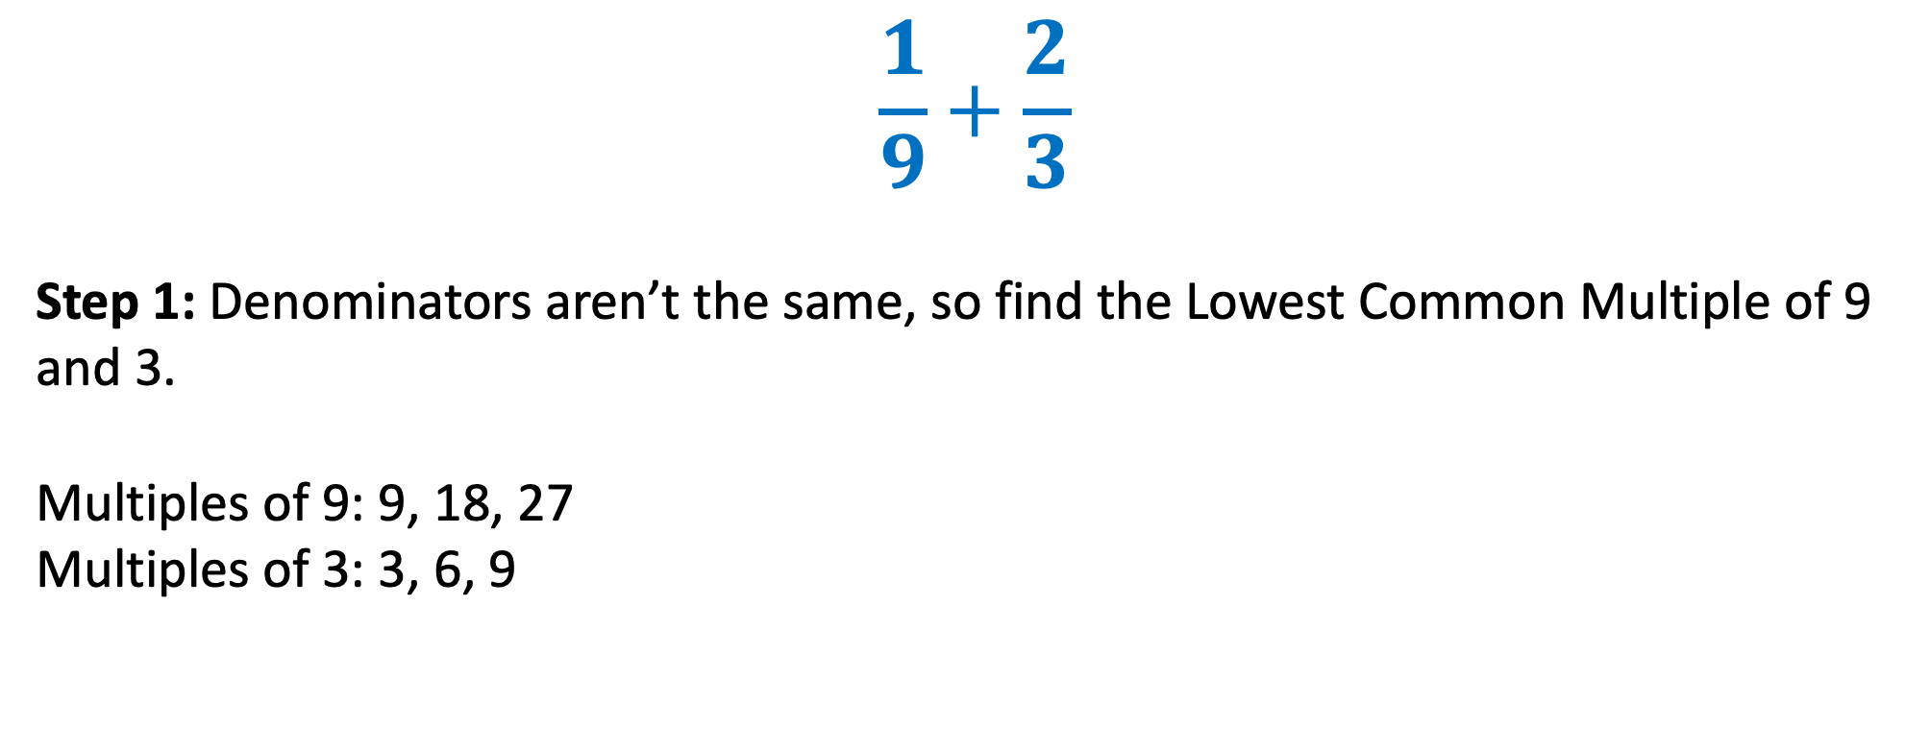
24
7
30
Algebraic Fractions
Date:
EQ – How does having different denominators affect how we add and subtract fractions?
IMPORTANT: When adding and subtracting algebraic fractions, the same rules apply as with normal fractions – The denominator must be the same.
$$\frac{1}{9}+\frac{2}{3}$$
Step 1: Denominators aren’t the same, so find the Lowest Common Multiple of 9 and 3.
Multiples of 9: 9, 18, 27
Multiples of 3: 3, 6, 9
9 is the lowest common multiple of 9 and 3, so 9 will be our denominator

Slide 6
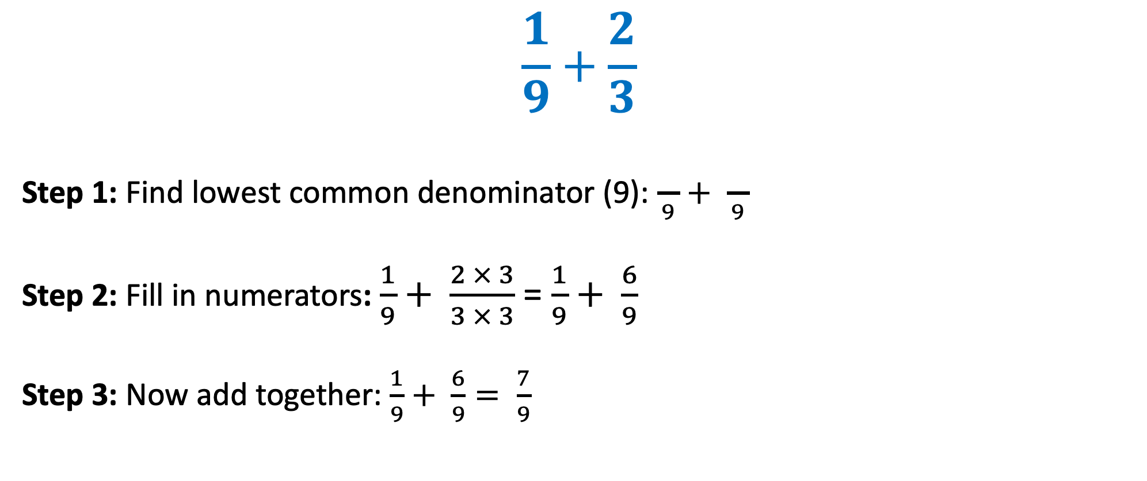
24
7
30
Algebraic Fractions
Date
EQ – How does having different denominators affect how we add and subtract fractions?
$$\frac{1}{9}+\frac{2}{3}$$
Step 1: Find lowest common denominator (9): $\frac{}{9}+ \frac{}{9}$
Step 2: Fill in numerators: $\frac{1}{9}+ \frac{2 × 3}{3 × 3}$ = $\frac{1}{9}+ \frac{6}{9}$
Step 3: Now add together: $\frac{1}{9}+ \frac{6}{9}= \frac{7}{9}$

Slide 7


Slide 8
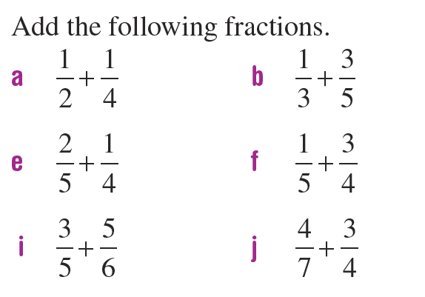
We do
You do

Slide 9
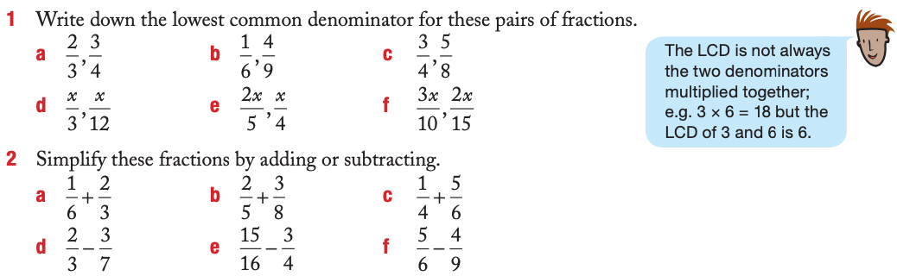
We do
Understanding

Slide 10
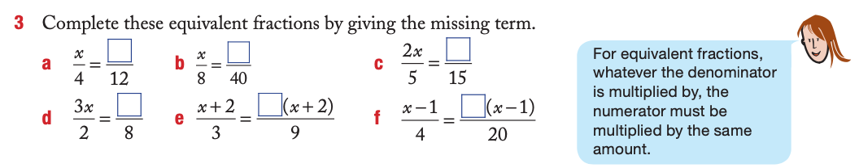
We do
Extension

Slide 11
Notes Review
24, 7 ,30
Date
Title
Essential question
Notes complete
Notes complete with colour and diagrams
Questions completed
Contents page filled in
Formula page filled in

Slide 12
Homework
Review your notes, finish any unanswered questions and write a summary answering the Essential Question.

